Slide 1


Parallel and Distributed Systems / 3
Pavel Krömer, Dept. of Computer Science, VSB – Technical University of Ostrava

Slide 2
Agenda
Major topics
Shared memory systems, open multiprocessing, OpenMP
Literature
Barbara Chapman, Gabriele Jost, Ruud van der Pas, Using OpenMP Portable Shared Memory Parallel Programming, MIT Press, 2008
Peter Pacheco, An Introduction to Parallel Programming, Elsevier, 2011 (Ch. 4, 5)

Slide 3
Shared memory systems
Notes:
what do we associate with digital transformation/DSM?
Is that all new? Is this change the first?

Slide 4
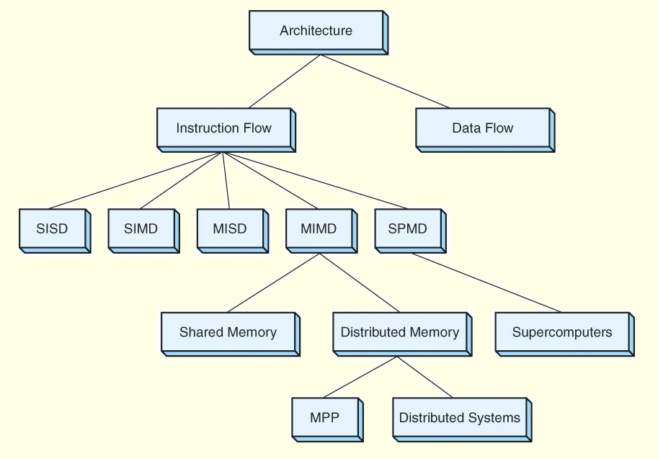

Slide 5
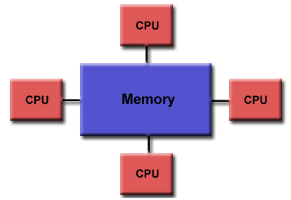
Shared memory systems
Tightly coupled systems
All processors have access to the complete memory (as a global [shared] address space)
Processors can operate independently but share memory resources and I/O
Changes in memory caused by one processor are visible to all other

Slide 6
Shared memory systems
Uniform memory access (UMA)
AKA Symmetric Multiprocessors (SMPs)
Systems of identical processors with equal access and access times to memory
Sometimes called Cache Coherent UMA (CC-UMA)
if one processor updates a location in shared memory, all the other processors know about the update
cache memories that provide access to these variables are kept consistent
accomplished at the hardware level (snoopy/sniffy bus protocol)

Slide 7
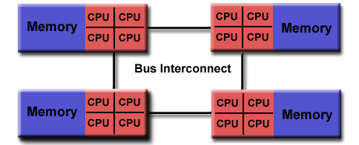
Shared memory systems
Non-uniform memory access (NUMA)
One SMP can directly access memory of another SMP
Not all processors have equal access time to all memories
Memory access across link is slower
Cache Coherent NUMA (CC-NUMA) if cache coherency is achieved

Slide 8
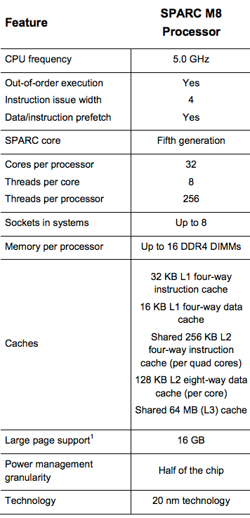
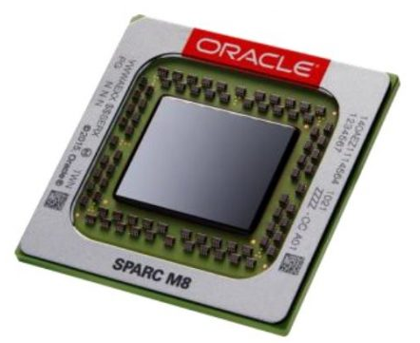
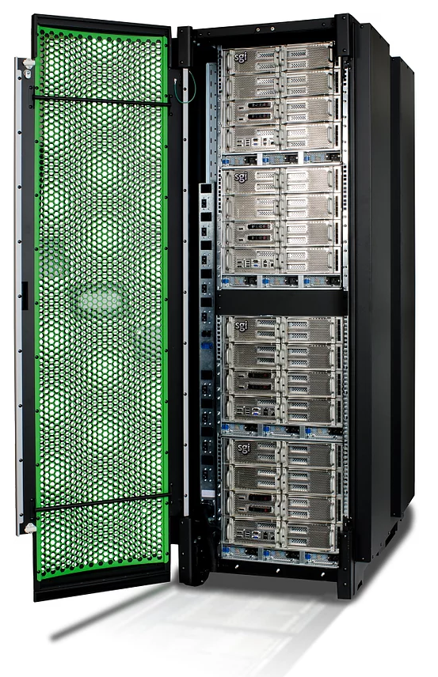
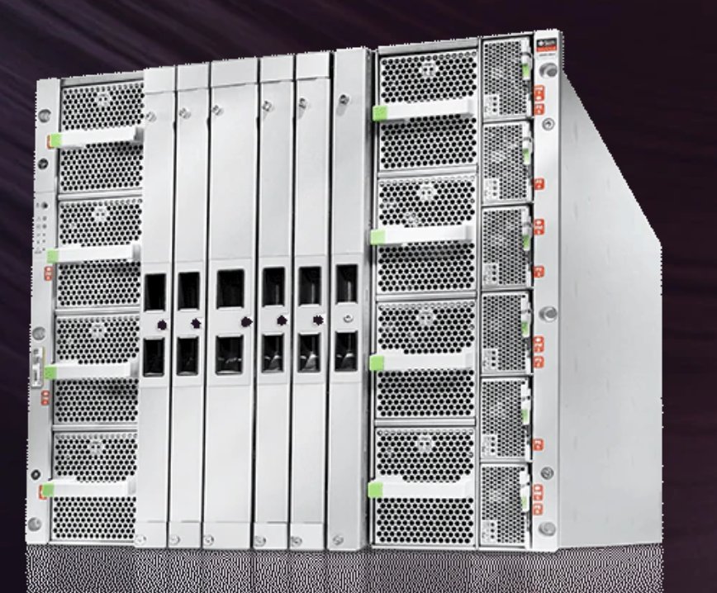
Shared memory systems
SGI UV 3000 SMP system scales
up to 256 sockets /x16 cores/ and 64TB of coherent shared memory with industry-standard Intel® Xeon® v3 processors and Linux® O/S
SPARC M8-8 / 2048/ 8TB

Slide 9
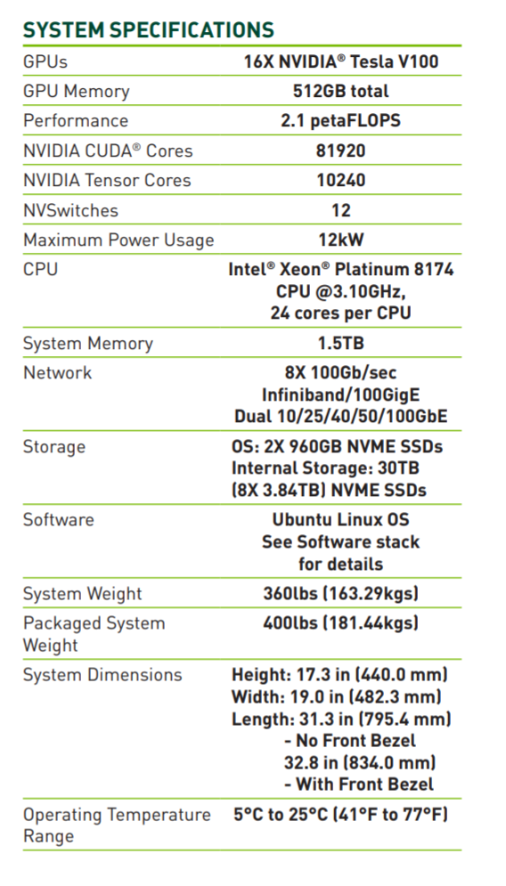
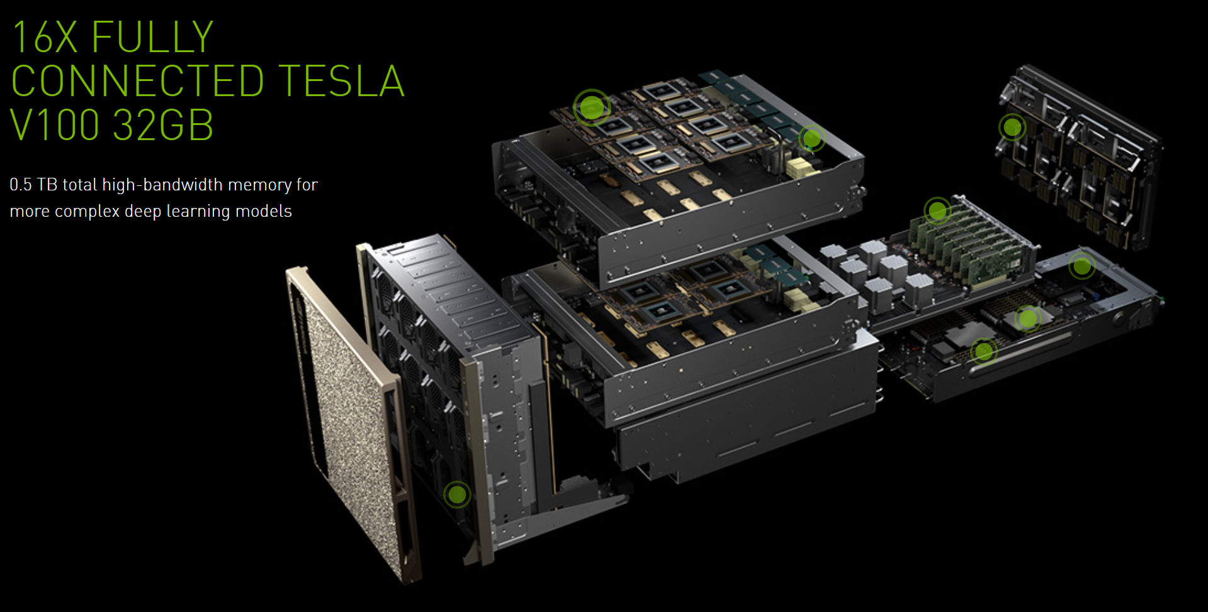
Shared memory systems
New architectures in town
Nvidia DGX-2(H)

Slide 10
Shared memory systems
Pros and cons
Advantages
Global address space provides a user-friendly programming access to memory
Data sharing between tasks is both fast and uniform due to the proximity of memory to CPUs
Disadvantages
Lack of scalability between memory and CPUs. Adding more CPUs can geometrically increases traffic on the shared memory-CPU path, and for cache coherent systems, geometrically increase traffic associated with cache/memory management
Programmer responsibility for synchronization constructs that ensure "correct" access of global memory.

Slide 11
Programming shared memory systems
Notes:
what do we associate with digital transformation/DSM?
Is that all new? Is this change the first?

Slide 12

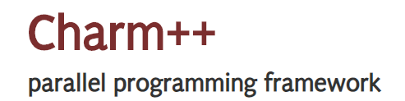






Shared memory systems
Basic considerations
ability to execute data vs. task parallel programs
SIMD vs. MIMD (wrt. SPMD)
High-level strategies
use of some low or high-level mechanism for multi-process and/or multi-thread parallel computation
communication usually (but not exclusively) through shared memory
open multiprocessing (OpenMP)
+ a plethora of platform/language/domain specific tools
Notes:
Intel® Cilk™ Plus - an extension to the C and C++ languages to support data and task parallelism - is being deprecated in the 2018 release of Intel® Software Development Tools.
Example of fast development in the field

Slide 13
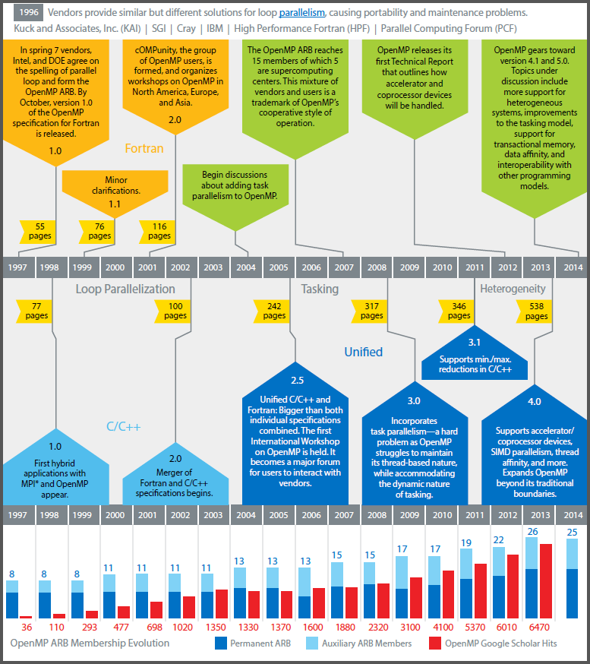
Open Multiprocessing
Industry standard API for C/C++ and Fortran shared memory parallel programming
governed by OpenMP Architecture Review Board
major HW/SW and compiler vendors (Intel, PGI NVidia, IBM, AMD, Cray, Oracle, . . . )
Multiple versions
1.0 (Fortran ’97, C ’98) - 3.1 (2011) shared memory
4.0 (2013) accelerators, NUMA
4.5 (2015) improved memory mapping, SIMD
5.0 (2018) improved accelerator support
Issues dealt with
Fortran/C++
accelerators, offloading to device

Slide 14
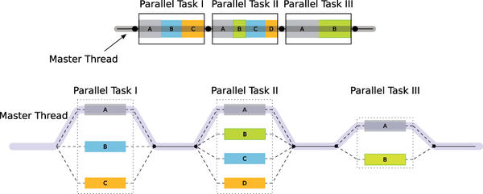
Execution model: fork-join
Fork-join programming model
one master thread that executes all serial regions
master forks new worker threads at the beginning of parallel regions
parallel threads share the work and sync at the end parallel regions
each thread works with shared and private variables (for convenience, all in the global shared address space)
Join
Join
Join
Fork
Fork
Fork

Slide 15
Implementation: directive-based
The programmer specifies what, the compiler decides how
best practices and patterns
automation and optimization
portability
single source for sequential/parallel code
An OpenMP program consists of
compiler directives and clauses ( #pragma omp parallel )
library functions ( omp_get_num_threads() )
environment variables ( OMP_NUM_THREADS )

Slide 16
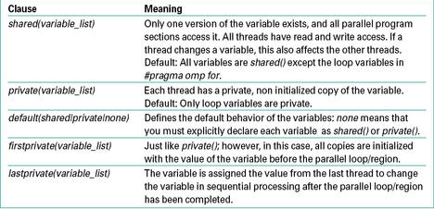
Implementation: directive-based
Clauses of parallel directives specify
conditional parallelization
to determine if the parallel construct results in creation/use of threads if (scalar-expression)
degree of concurrency
to explicitly specify the number of threads created/used num_threads(integer-expression)
data handling
to indicate variable scope (local, global, or ‘special’) private(variable-list) shared(variable-list) firstprivate(variable-list) default(shared j none)

Slide 17
The parallel directive
Indicates a parallel region
creates a group of threads (OMP_NUM_THREADS, omp_set_num_threads(nthreads))
each thread executes the structured block of code (possibly the same code!)
Examples
# pragma omp parallel if (is_parallel == 1) num_threads(8) private(a) shared(b) firstprivate(c)
if the value of variable is_parallel is one, eight threads are used • each thread has private copy of a and c, but all share one copy of b
the value of each private copy of c is initialized to value of c before the parallel region
# pragma omp parallel reduction(+ : sum) num_threads(8) default(private)
eight threads get a copy of the variable sum
when threads exit, the values of these local copies are accumulated into the sum variable on the master thread – other reduction operations include *, -, &, |, ^, &&, || • all variables are private unless otherwise specified

Slide 18
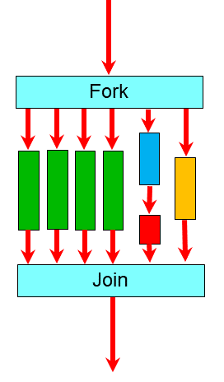
The parallel directive
Examples (cont.)
#include <omp.h>
…
int main()
{
int tid, nthreads;
#pragma omp parallel private(tid)
{
tid = omp_get_thread_num();
printf(”Hello World from thread %d\n", tid);
#pragma omp barrier
if ( tid == 0 )
{
nthreads = omp_get_num_threads();
printf(”Total threads= %d\n",nthreads);
}
}
}

Slide 19
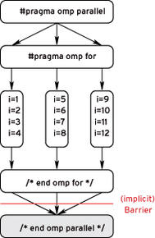
The for work-sharing directive
Example
#include <cmath>
…
int main()
{
const int size = 256;
double sinTable[size];
#pragma omp parallel
{
…
#pragma omp for
for(int n=0; n<size; ++n)
sinTable[n] = std::sin(2 * M_PI * n / size);
…
}
}
Solves a typical problem – parallelization of a for loop
requirement: independent iterations
the loop index automatically assumed private
extra code reduced to only two directives plus sequential code (code is easy to read/maintain)
implicit synchronization at the end of the loop (can be overriden by the nowait clause)
Very often merged together with parallel
#pragma omp parallel for

Slide 20
The reduce clause
Solves another typical problem – reduction
a well-known parallel pattern in shared memory programming
combines all the elements in a collection into one using an associative two-input, one-output operator
reductions are used in many algorithms to compute error metrics and termination conditions for iterative algorithm

Slide 21
A more complex example
Examples (cont.)
#include <omp.h>
…
main ()
{
int i, n, chunk;
float a[100], b[100], result;
n = 100; chunk = 10; result = 0.0;
for (i=0; i < n; i++)
{
a[i] = i * 1.0;
b[i] = i * 2.0;
}
#pragma omp parallel for default(shared) private(i) schedule(static,chunk) reduction(+:result)
for (i=0; i < n; i++)
result = result + (a[i] * b[i]);
}
Parallel, for and reduction working together

Slide 22
Pros and cons of OpenMP
Advantages
simple programming model
single source code for serial and parallel version
portable and well-supported (gcc)
code works in serial without adjustments
Disadvantages
can only be run in shared memory computers
requires a compiler that supports OpenMP
high risk of race conditions

